Slide 1
PaNOSC @ Joint ESS + ILL Users Meeting
23 September 2020
Andy Götz (ESRF) - Project Coordinator Jon Taylor (ESS), Thomas Rod (ESS), Jamie Hall (ILL), Shervin Nourbakhsh (ILL) Jean-Francois Perrin (ILL/ESRF), Stuart Caunt (ILL), Tobias Richter (ESS)

Slide 2
Outline
Who
Why
→ What
→ When
→ Use Cases
This project has received funding from the European Union’s Horizon 2020 research and innovation programme under grant agreement No. 823852

Slide 3











PaNOSC factsheet
Call: Horizon 2020 InfraEOSC-04
Partners: ESRF, ILL, XFEL.EU, ESS, CERIC-ERIC, ELI-DC, EGI
Description: cluster of ESFRI Photon and Neutron sources
Observers/non-funded: GÉANT, EUDAT, national RIs
Linked 3rd parties via EGI: DESY, STFC, CESNET
Status: Started 1/12/2018
Github: https://github.com/panosc-eu
Home page: https://panosc.eu
Twitter: @PaNOSC_eu #PaNOSC
Budget: 12 M€
Coordinator: ESRF
Started: 1/12/2018
Duration: 4 years
Photon and Neutron Open Science Cloud
This project has received funding from the European Union’s Horizon 2020 research and innovation programme under grant agreement No. 823852

Slide 4
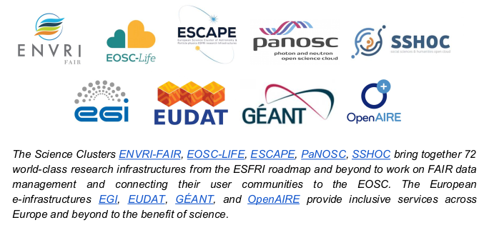
PaNOSC is one of 5 ESFRI clusters
“EOSC - a tool for enabling Open Science in Europe”
https://doi.org/10.5281/zenodo.4044009
This project has received funding from the European Union’s Horizon 2020 research and innovation programme under grant agreement No. 823852

Slide 5

PaNOSC + EOSC : building data services on FAIR data
= DATA + SERVICES
This project has received funding from the European Union’s Horizon 2020 research and innovation programme under grant agreement No. 823852

Slide 6
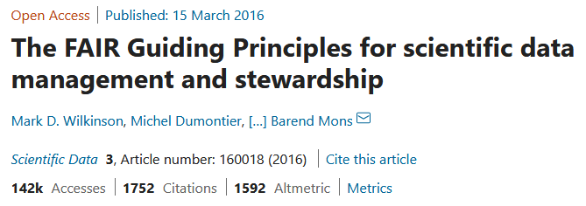
The paper that started it all
https://doi.org/10.1038/sdata.2016.18
This project has received funding from the European Union’s Horizon 2020 research and innovation programme under grant agreement No. 823852

Slide 7

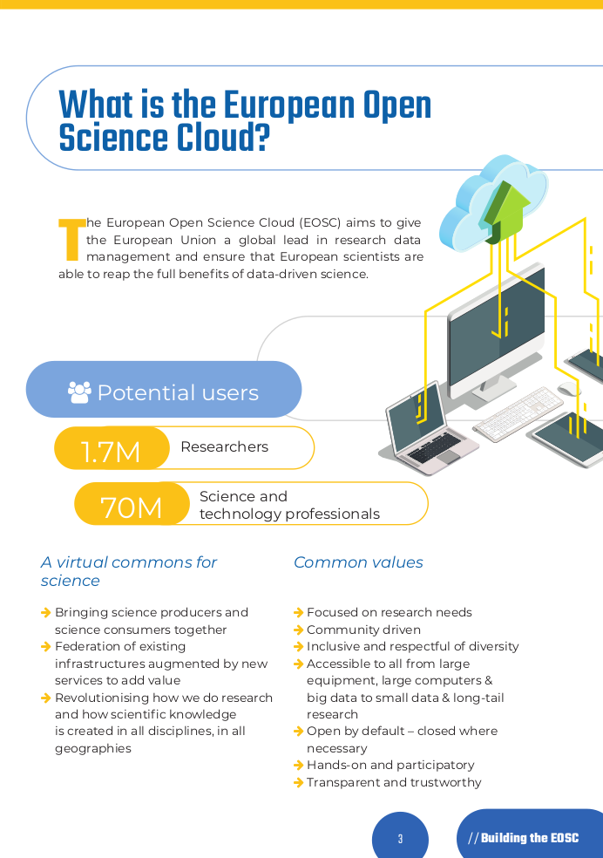
https://doi.org/10.5281/zenodo.3716191
This project has received funding from the European Union’s Horizon 2020 research and innovation programme under grant agreement No. 823852

Slide 8
What the EOSC is NOT :
A compute and storage cloud financed by the European Commission
This project has received funding from the European Union’s Horizon 2020 research and innovation programme under grant agreement No. 823852

Slide 9
Rename EOSC ?
EOSC = European Open Science Commons
This project has received funding from the European Union’s Horizon 2020 research and innovation programme under grant agreement No. 823852

Slide 10
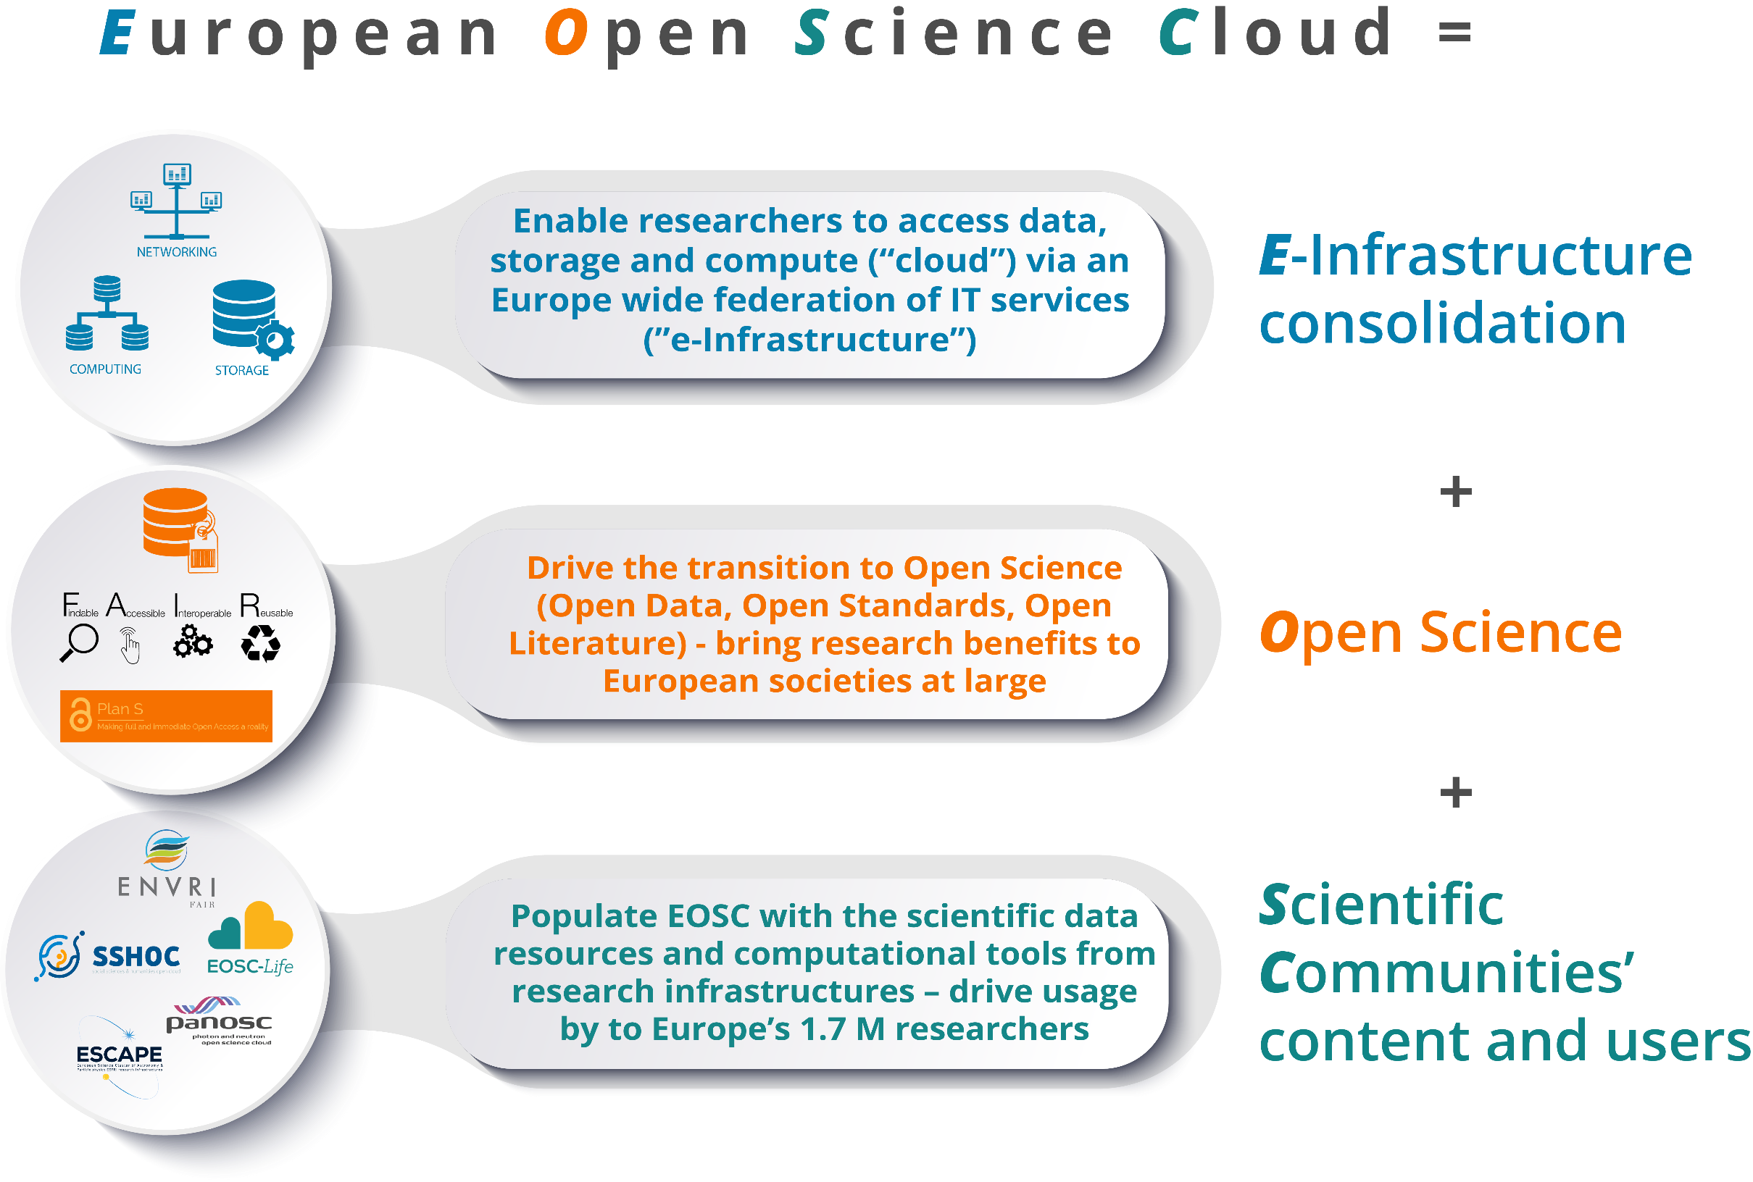
ESFRI clusters view of EOSC
This project has received funding from the European Union’s Horizon 2020 research and innovation programme under grant agreement No. 823852

Slide 11
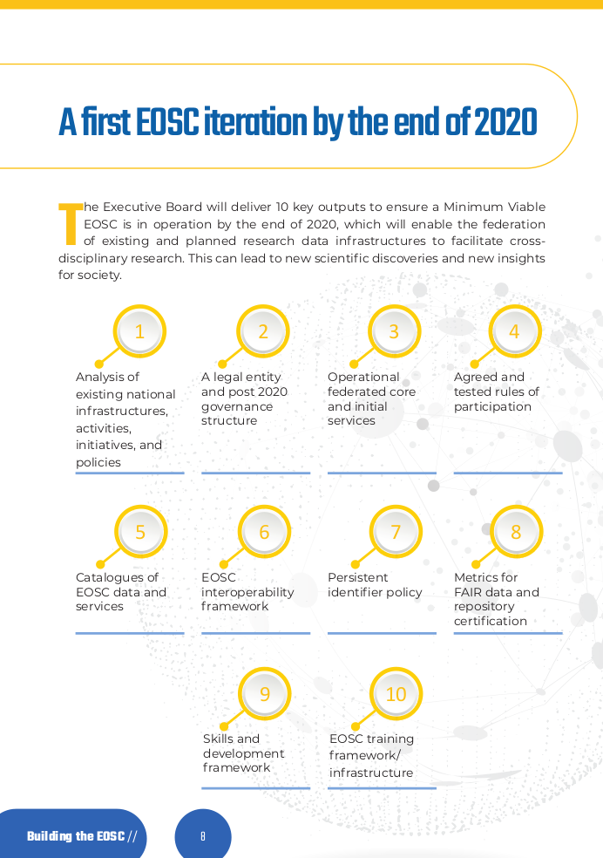
This project has received funding from the European Union’s Horizon 2020 research and innovation programme under grant agreement No. 823852

Slide 12
PaNOSC will provide by 2022
data policy framework persistent identifiers (DOIs) for data
Data management plans standard metadata Nexus/HDF5 electronic logbooks
open data
data search API
data portal Jupyter notebook service remote access desktops data simulation services data transfer service persistent user identities (AAI) scientific software catalogue e-training platform + material
Enabling Open Data +
Open Science
This project has received funding from the European Union’s Horizon 2020 research and innovation programme under grant agreement No. 823852

Slide 13
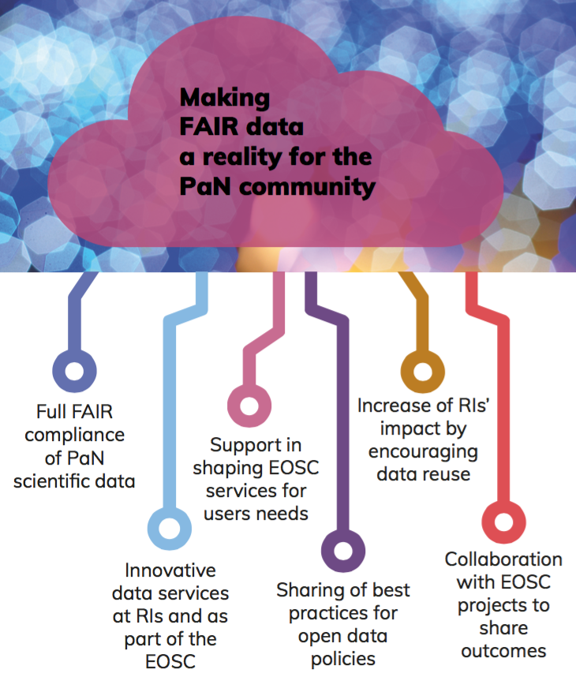

PaNOSC goals
PaNOSC works closely with the national PaN sources in Europe via ExPaNDS to develop common policies, strategies and solutions in the area of FAIR data policy, data management and data services, integrating them into the EOSC.
WP2
WP3
WP4
WP5
WP4
WP6
WP2
WP6
WP7
WP2
ALL WPs
WP4
WP5
WP6
This project has received funding from the European Union’s Horizon 2020 research and innovation programme under grant agreement No. 823852

Slide 14

ExPaNDS – Extending Photon and Neutron Data Services
Together PaNOSC+ExPaNDS represent all photon and neutron sources in Europe
PaNOSC and ExPaNDS are collaborating closely in all common Work Packages i.e. WP1, WP2, WP3, WP4, WP8, WP9
This project has received funding from the European Union’s Horizon 2020 research and innovation programme under grant agreement No. 823852

Slide 15

PaNOSC : building data services for Users
After 18 months preparing services PaNOSC will concentrate for the remaining 30 months on addressing common Use Cases identified by Users
A user is a person who utilizes a computer or network service. Users of computer systems and software products generally lack the technical expertise required to fully understand how they work. Power users use advanced features of programs, though they are not necessarily capable of computer programming and system administration (https://en.wikipedia.org/wiki/User_%28computing%29)
This project has received funding from the European Union’s Horizon 2020 research and innovation programme under grant agreement No. 823852

Slide 16

Use Case example
https://en.wikipedia.org/wiki/Use_case
Use Case: Edit an article
Primary Actor: Member (Registered User)
Scope: a Wiki system
Level: 1 (User goal or sea level)
Brief: The member edits any part (the entire article or just a section) of an article they are reading. Preview and changes comparison are allowed during the editing.
Stakeholders: Wiki User community
This project has received funding from the European Union’s Horizon 2020 research and innovation programme under grant agreement No. 823852

Slide 17
Where is my DATA?
How do I get them?
How do I look at them?
What does they mean?
Are they correct?
This project has received funding from the European Union’s Horizon 2020 research and innovation programme under grant agreement No. 823852
credits – Jon Taylor

Slide 18
Neutron Drivers for PaNOSC
The neutron user community has a very broad reach
Serving a large European user community of ~10k per year
Users from a multitude of different scientific backgrounds
Neutron experiments are no longer just for expert users
Complex Data and nuanced Data services - Data reduction (processing) Data analysis are accepted as a limiting factor to impact (Publications)
Volumes of data with modern instruments and sources are now far more difficult for users to handle.
This project has received funding from the European Union’s Horizon 2020 research and innovation programme under grant agreement No. 823852
credits – Jon Taylor

Slide 19
Findable
In the context of research in Quantum magnetism using TOF inelastic neutron scattering
Neutron experiments produce large numbers of data files.
Researchers need to be able to find where there data are.
Researchers may also need beam line correction data that they have not measured themselves
- A crystal is rotated in a spectrometer ~200 individual raw data sets are collected.
- Each raw data set must be processed (data reduction)
-Data must be corrected using a pre measured correction data set facility owned.
Each corrected data file is combined to a large volume data set with 4 dimensions
-Qx,Qy,Qz, Energy Transfer.
Data volume ~5TB
Meta data includes all sample parameters and all instrument parameters (in principle)
This processes is for one single point in a phase diagram, in principle if time allowed one could parametrically perform such measurements to map excitations in the phase diagram.
This is a clear case for excellence in data cataloging to track runs and metadata.
Currently paper log books work and extensively used well but are obviously flawed when one considers meta data needs for future reuse. E-logs would be far better but are challenging to implement to ensure they are used.
It is common to make parametric scans of temperature, Applied field, sample concentration, isotope contrast & labelling. Along with standard sample runs for vanadium, empty cells, empty instruments.
This project has received funding from the European Union’s Horizon 2020 research and innovation programme under grant agreement No. 823852
credits – Jon Taylor

Slide 20
Accessible
In the context of research in Quantum magnetism using TOF inelastic neutron scattering
I now have 5TB of experimental data and a laptop with a 256GB SSD :(
Access to experimental data via a portal to facility (or other) compute infrastructure is essential to allow efficient progress and not orphan the investigation.
Access also includes access to software and data services to allow processing and analysis to take place efficiently.
Data portals
Data services (DAaaS)
Accessibility should also be taken as enabling non expert users to access the methods and techniques - this requires training (and facility /community collaboration)
Covid-19 means access to the facility through remote means …
Portal to data, compute and instruments (Covid-19) are essential
credits – Jon Taylor
This project has received funding from the European Union’s Horizon 2020 research and innovation programme under grant agreement No. 823852

Slide 21
Interoperable
In the context of research in Quantum magnetism using TOF inelastic neutron scattering
A multidisciplinary study will include:
Neutron diffraction - power and single crystal.
Lab Based methods - sample preparation and sample characterisation (Magnetisation measurements)
Photon based methods - X-Ray Circular Dichroism, RIXS, ARPES.
The user wants to view / compare / analyse common data together I.e. INS and RIXS
Nexus Data format - similar data formats provide a single format for storing data which should allow interoperability of software (at least at the load stage)
This provisions interoperable data analysis & Co refinements
Use of a common software environment - like Python based Jupyter notebook data services reduces the complexity that the user faces and allows for multiple experimental data types to be compared.
The breadth and heterogeneity of data and experiment types poses a significant challenge.
credits – Jon Taylor
This project has received funding from the European Union’s Horizon 2020 research and innovation programme under grant agreement No. 823852

Slide 22
Reusable
In the context of research in Quantum magnetism using TOF inelastic neutron scattering
Reuse could be normal collaboration.
- Published data is reused or referenced in future publications from the same group, or collaborators.
The original INS experimental data are processed and analysed more than once by the original PI and team. This can happen months / years after the original experiment based on results / motivations from subsequent experiments.
The original team need to be able to reuse their own data
- Reuse by third parties i.e. open scientific data.
- Represents a real challenge.
- Meta data, and rich meta data and auxiliary data are essentai
DOIs for data and software releases
credits – Jon Taylor
This project has received funding from the European Union’s Horizon 2020 research and innovation programme under grant agreement No. 823852

Slide 23
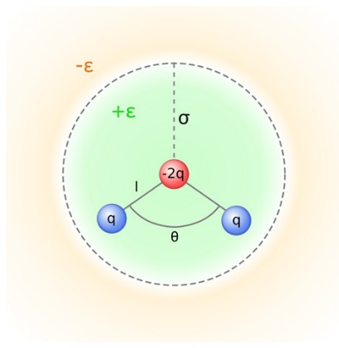
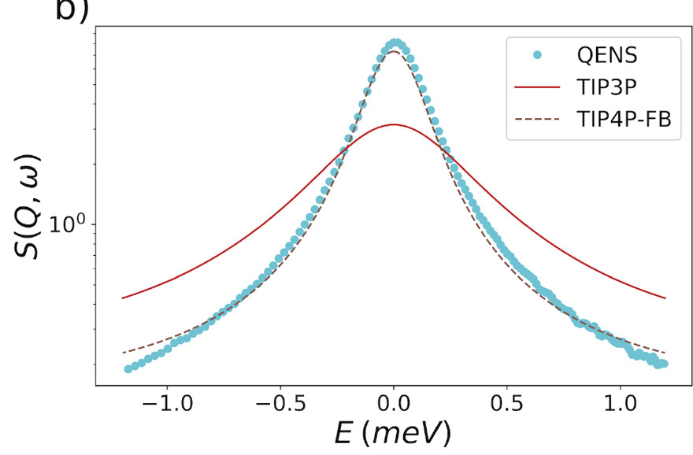
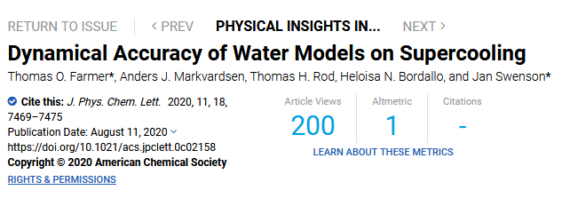
Reusability of data – an example
Supercooled water
QENS data published in 2011
(Qvist, Schober & Halle, JCP 2011)
Reused in 2020 by different group of scientists for evaluating water models
T=293 K, Q=1.0 Å⁻¹
credits – Thomas Rod
This project has received funding from the European Union’s Horizon 2020 research and innovation programme under grant agreement No. 823852
Notes:
Got data directly from Bertil Halle
Data acquired at ILL
Figure: S(Q, ω) of the QENS data compared with TIP3P and TIP4P-FB at 293 K for Q values of 1.0 Å–1.

Slide 24

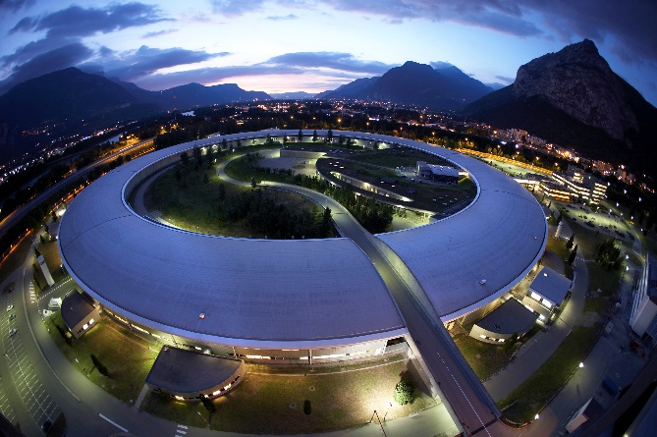
ESRF : Use Cases
User 1: How can I download 5 TBs of raw data?
User 2: How can I search, view and process data remotely?
User 3: How can I access a Jupyter notebook to process my data?
User 4: How can I make my data open and get a DOI to cite?
User 5: How can I get credentials to login and use these services?
Beamline scientist: How can I provide standard notebooks for processing data for my users?
This project has received funding from the European Union’s Horizon 2020 research and innovation programme under grant agreement No. 823852

Slide 25
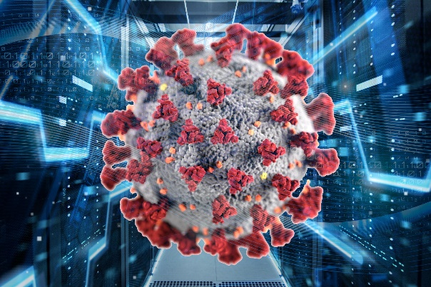
COVID-19 : Use Cases
PaNOSC + EOSC should offer:
Remote access
Downloadable Metadata & Raw data
Software service to browse and analyse raw data
Platform as a service to do computations + simulations
Common space to share progress and workflows
This project has received funding from the European Union’s Horizon 2020 research and innovation programme under grant agreement No. 823852

Slide 26
VISA = ILL remote access for COVID-19
Provide remote data analysis services with access to
Experimental data
Analysis software
Compute infrastructure
Support (IT and Scientific)
Make access as simple as possible using a web browser
Remote desktop as if the user was sitting in front of an ILL data treatment workstation
Easy and flexible machine management
Allow scientific collaborations
Sharing desktops
Enable remote experiments
Access Nomad (SCI) to perform instrument control
This is the current priority for the next reactor cycle (August)
credits – Jamie Hall (ILL) + Stuart Caunt (ILL)
This project has received funding from the European Union’s Horizon 2020 research and innovation programme under grant agreement No. 823852

Slide 27
ILL VISA architecture
Very similar to PaNOSC portal architecture
Token creation
VISA
OpenStack
Web Application
Angular6
Linux VM
Linux VM
Keycloak
OpenID Connect
Linux VM
RDP /
guacd
Instance Management
REST API
Remote Desktop Access
Socket.io
Token validation
Instance
management
Session authorisation and
Session management
REST API
Business logic
DB
credits – Jamie Hall (ILL) + Stuart Caunt (ILL)
This project has received funding from the European Union’s Horizon 2020 research and innovation programme under grant agreement No. 823852

Slide 28
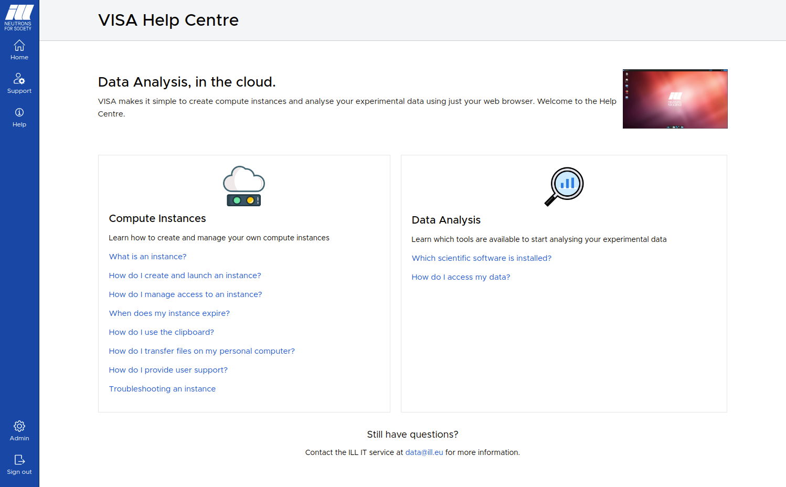
ILL VISA remote services
Very similar to PaNOSC portal architecture
credits – Jamie Hall (ILL) + Stuart Caunt (ILL)
This project has received funding from the European Union’s Horizon 2020 research and innovation programme under grant agreement No. 823852

Slide 29
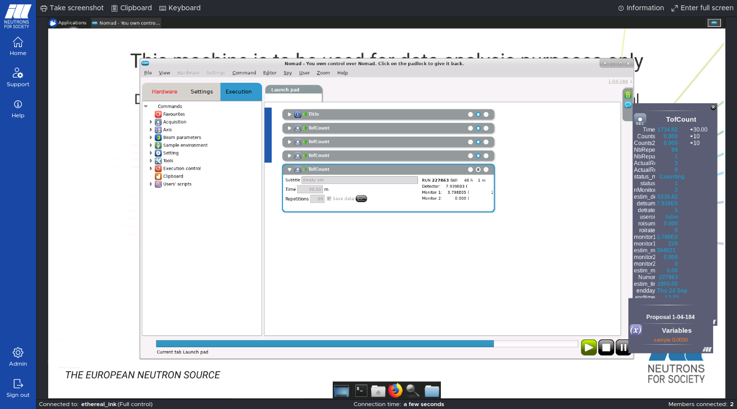
ILL VISA remote experiments
Very similar to PaNOSC portal architecture
credits – Jamie Hall (ILL) + Stuart Caunt (ILL)
This project has received funding from the European Union’s Horizon 2020 research and innovation programme under grant agreement No. 823852

Slide 30
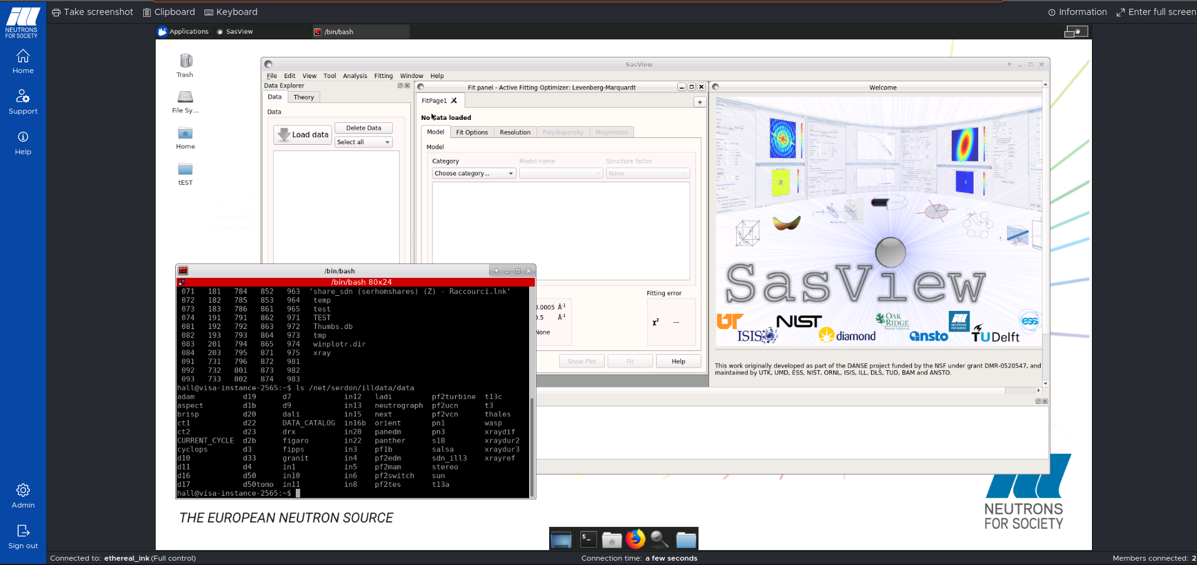
ILL VISA remote analysis
Very similar to PaNOSC portal architecture
credits – Jamie Hall (ILL) + Stuart Caunt (ILL)
This project has received funding from the European Union’s Horizon 2020 research and innovation programme under grant agreement No. 823852

Slide 31
ILL VISA remote services usage since 11 August 2020
Number of instances by type of user:
Instrument Responsibles 291
External users 235
Session stats:
User type Count Average duration (m)
Instrument responsible 3614 121
External user 3578 99
credits – Jamie Hall (ILL) + Stuart Caunt (ILL)
This project has received funding from the European Union’s Horizon 2020 research and innovation programme under grant agreement No. 823852

Slide 32
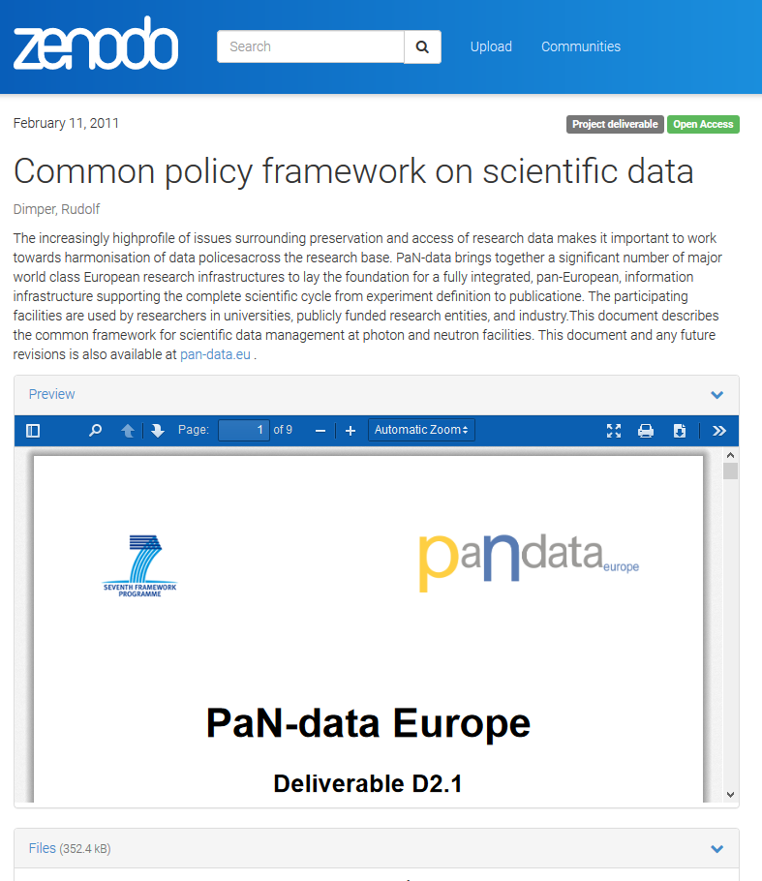
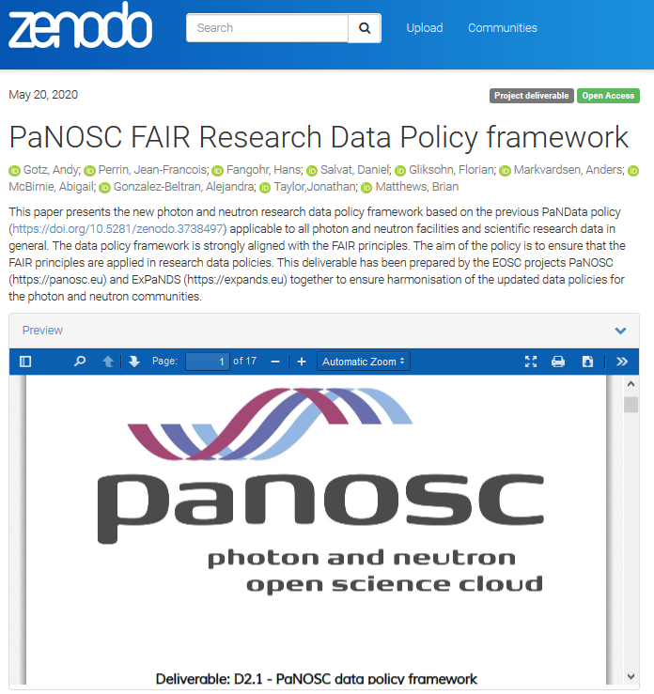
PaNOSC making Data Policies FAIR
WP2
This project has received funding from the European Union’s Horizon 2020 research and innovation programme under grant agreement No. 823852
Next step is to implement templates for Data Management Plans / Computational Needs Plans

Slide 33
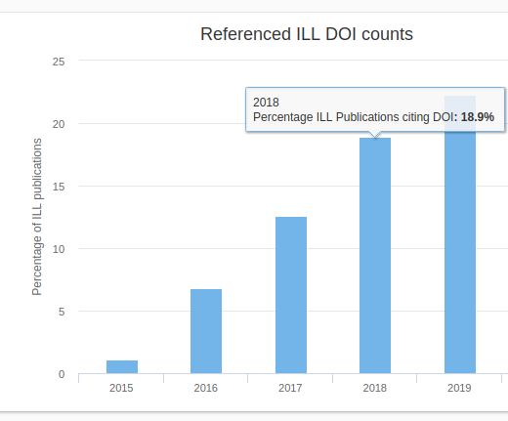
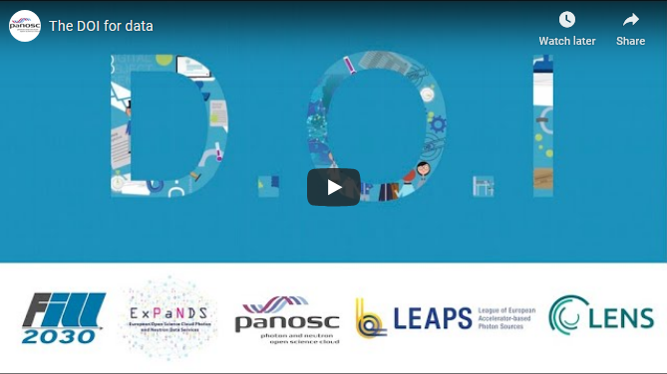
Citing DOIs for DATA
Users must cite data DOIs in publications
Journals must request DOIs for data
Watch the video here https://youtu.be/ekn0qicVFJM
This project has received funding from the European Union’s Horizon 2020 research and innovation programme under grant agreement No. 823852

Slide 34
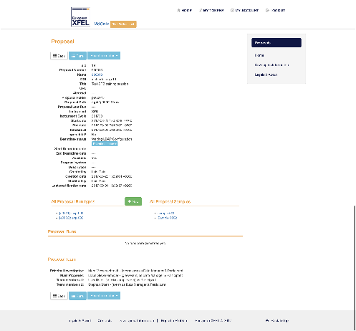
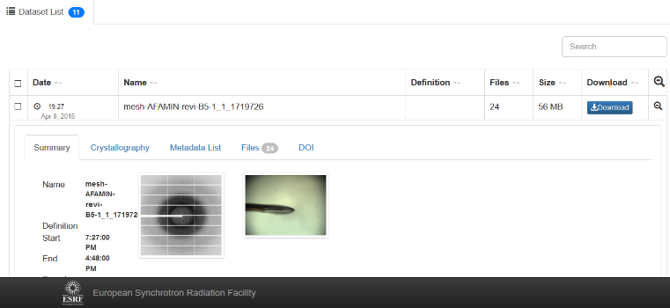
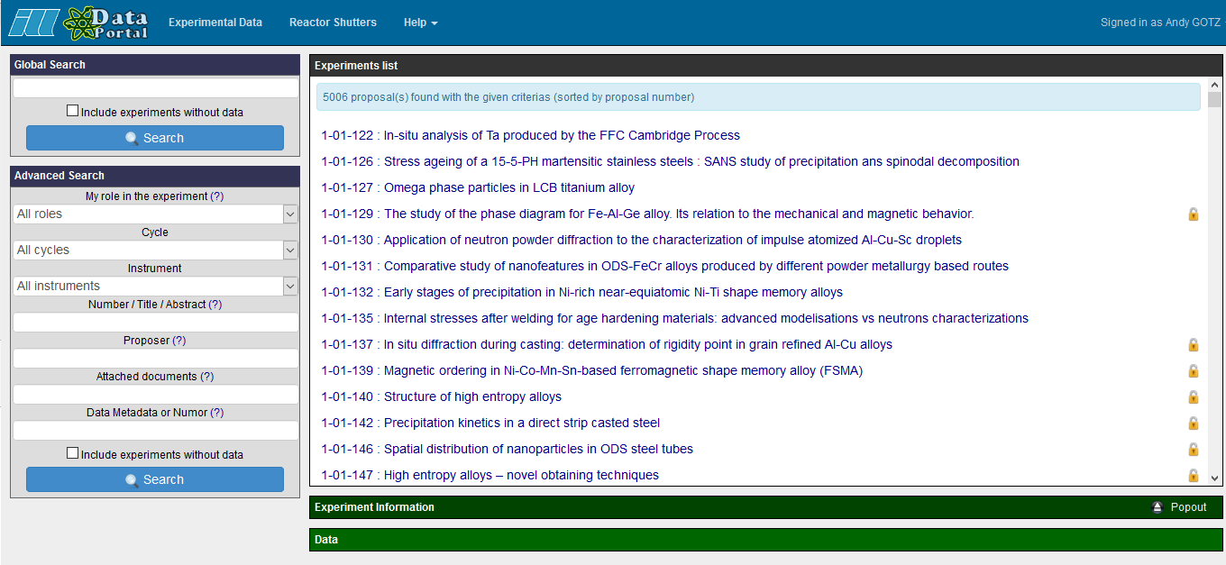
PaNOSC has 6 data catalogues with different APIs + UIs
WP3
ESRF
(icat)
CERIC
(icat)
ESS
(SciCat)
ILL
(local)
ELI
(tbd)
XFEL
(MyMdc)
This project has received funding from the European Union’s Horizon 2020 research and innovation programme under grant agreement No. 823852

Slide 35

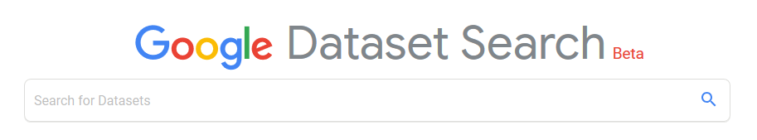
PaNOSC common search API across all sites
WP3
Common API to search across all PaNOSC catalogues
ESRF
(icat)
CERIC
(icat)
ESS
(SciCat)
ILL
(local)
ELI
(tbd)
XFEL
(MyMdc)
This project has received funding from the European Union’s Horizon 2020 research and innovation programme under grant agreement No. 823852

Slide 36
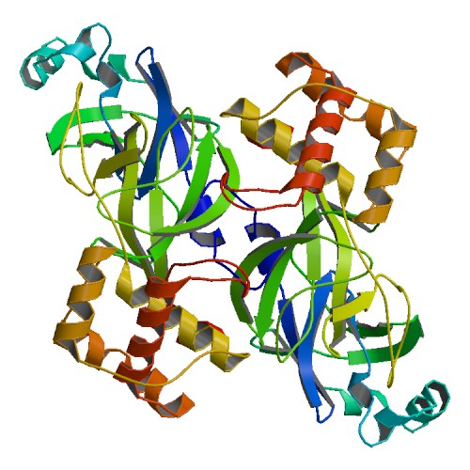
COVID-19 : a test for PaNOSC and EOSC
FAIR data & Downloadable Metadata & Raw data : In Progress
→ e.g. ESRF has 15 Coronavirus structures in the Protein Data Bank but little raw data …
SARS-CoV/2c3s, SARS-CoV/2beq, SARS-CoV/2bez, SARS-CoV/2h85, bovine-coronavirus/3cl4, bovine-coronavirus/3cl5, HCoV-OC43/6qfy, MERS-CoV/4ud1, MERS-CoV/6g13, murine_coronavirus/4c7l, murine_coronavirus/4c7w, murine_coronavirus/5jif, murine_coronavirus/5jil, 2cme, SARS-CoV/2xyr, SARS-CoV/2xyv, SARS-CoV/2fav, SARS-CoV/1qz8, SARS-CoV/1uw7
SARS-CoV/2c3s
This project has received funding from the European Union’s Horizon 2020 research and innovation programme under grant agreement No. 823852

Slide 37
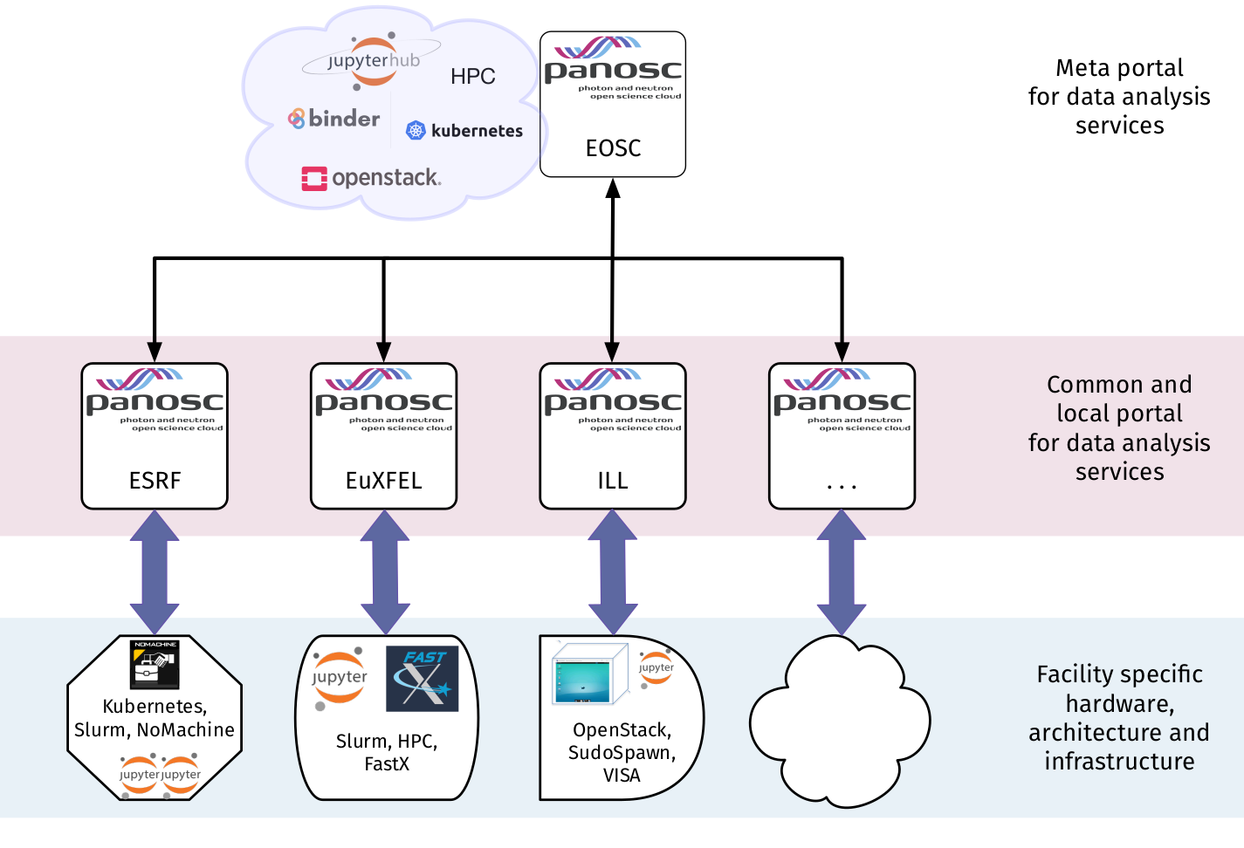

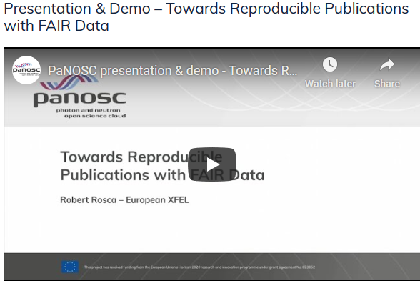

WP4

Slide 38
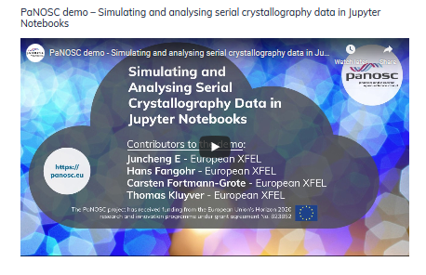
Simulation services - ViNYL
WP5
Virtual Neutron and x-raY Laboratory (ViNYL) will:
Offer services for simulation and modelling of photon and neutron instruments, as well as start-to-end simulations to describe entire experiments at photon and neutron facilities
Make simulation data services inter-operable among the involved partners, such as OASYS, McSTAS and SIMEX
Enable RIs to seamlessly link this experiment simulation services to their in-house data reduction, analysis, and visualization infrastructures.
SIMEX is responsible for photon experiment simulations
This project has received funding from the European Union’s Horizon 2020 research and innovation programme under grant agreement No. 823852

Slide 39

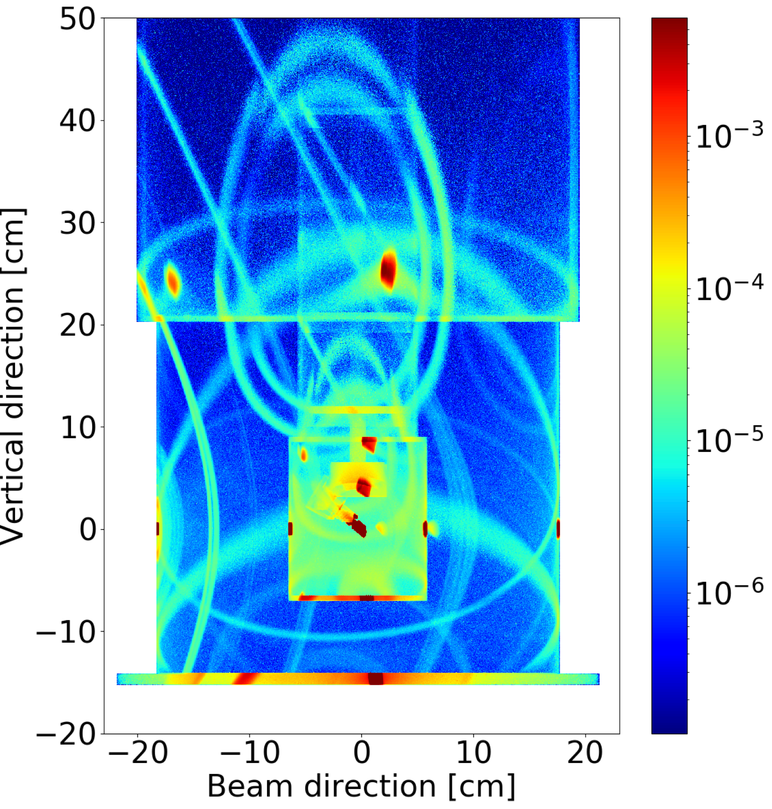
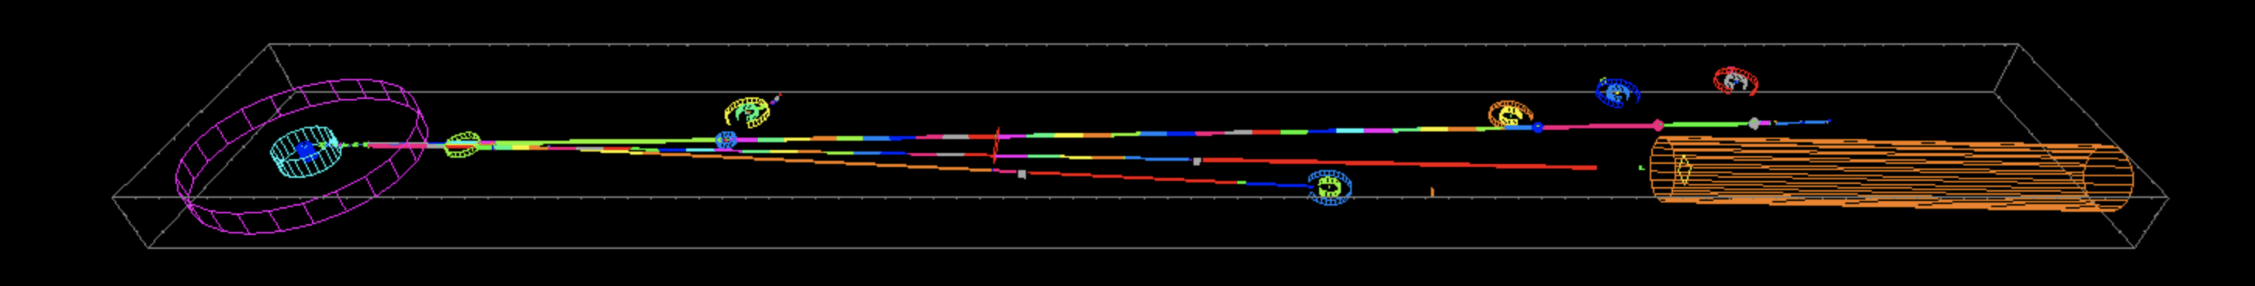
Simulation of instrumentation in the cloud
PaNOSC work package 5 provides simulations services in a cloud environment
McStas is capable of instrument and sample simulation
McStasScript is an open source python API for McStas
Can run simulations in Jupyter Notebook with
Built in help functions
Auto completion of parameter names
Ability to run simulation and visualize data
Data available in numpy arrays
Sample and sample environment
ILL H5 guide system
and instruments
This project has received funding from the European Union’s Horizon 2020 research and innovation programme under grant agreement No. 823852
credits – Thomas Rod (ESS) + Mads Bertelsen (ESS)

Slide 40
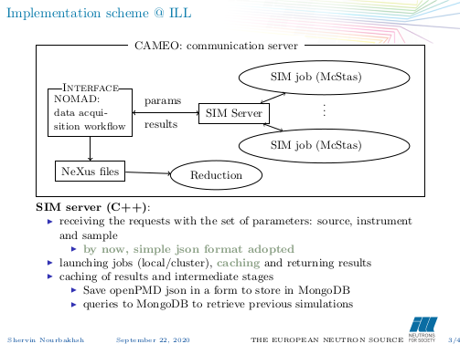
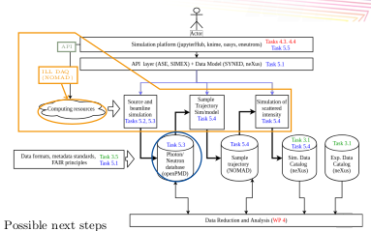
ViNYL simulation services @ ILL
Work being carried out @ ILL by Shervin Noubakhsh in WP5
This project has received funding from the European Union’s Horizon 2020 research and innovation programme under grant agreement No. 823852
credits – Shervin Noubakhsh (ILL)

Slide 41
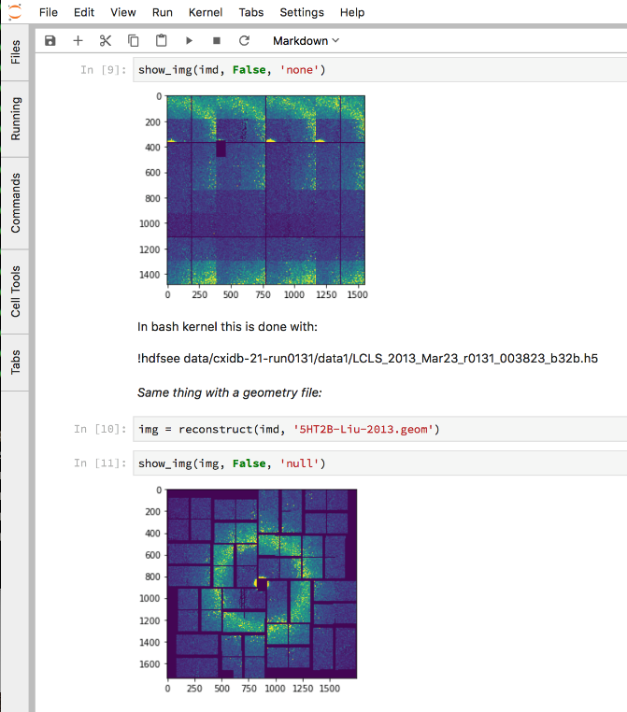
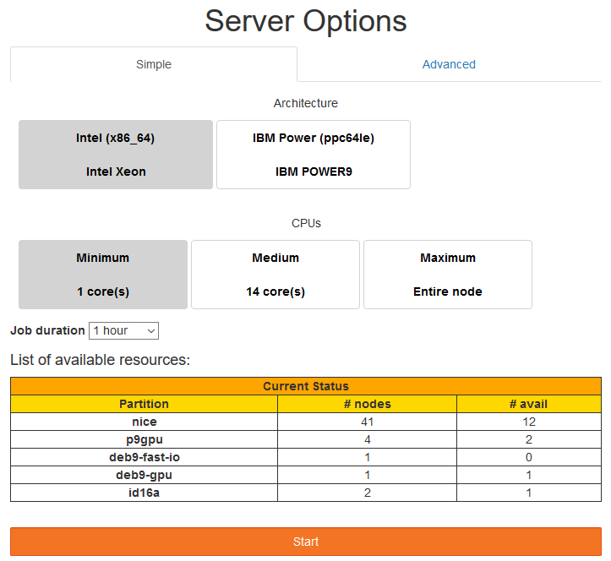
Jupyter Notebook service to view, process and analyse raw data
ILL, ESS, ESRF, EuXFEL CERIC-ERIC, ELI and EGI are committed to providing remote Jupyter notebook analysis services :
Jupyter → EuXFEL, ILL, ESRF, CERIC-ERIC, EGI in production, ESS + ELI in test
Desktop → ILL, EuXFEL, ESRF, CERIC-ERIC, EGI in production
HPC → EuXFEL, ILL, EGI in production for local users
This project has received funding from the European Union’s Horizon 2020 research and innovation programme under grant agreement No. 823852

Slide 42
EOSC Integration – Data transfer
WP6
3 uses cases :
User driven data transfer of GB to TBs (Globus Online)
Data archiving for RIs (STFC as the archive center)
Transfer from RIs to compute facilities on behalf of users (i.e. based on the scenario where users perform analysis on a different infra than the one of the RI where the data have been produced). Currently exploring OneData.
Pilots with EGI Support of Use Case 2 &3, evaluating :
Integration with the existing RI IT infra
AAI interoperability
Limit of the model in terms of data volume
This project has received funding from the European Union’s Horizon 2020 research and innovation programme under grant agreement No. 823852

Slide 43
Outreach Events & Developments
WP3 WP4 WP5
WP8
1st PaNOSC OASYS School, 14-16 May 2019, Grenoble – France
HDF5 European Workshop for Science and Industry, 17-18 September 2019, @ESRF, Grenoble
h5py code camp, 19-20 September 2019, @ESRF, Grenoble
Nexus data format – extend for synchrotron, FELs + lasers, generalize use of Nexus in PaN community
hdf5 – h5py python library for manipulating hdf5 files + h5web web viewer of hdf5
Jupyter notebooks – integrated into slurm, h5web viewer in jupyterlab, provide notebooks for use cases
Data portal – developing a PaN portal for generic services + remote desktop (based on VISA)
Pan-learning – integrate jupyter notebooks into moodle (based on e-neutrons.org)

Slide 44
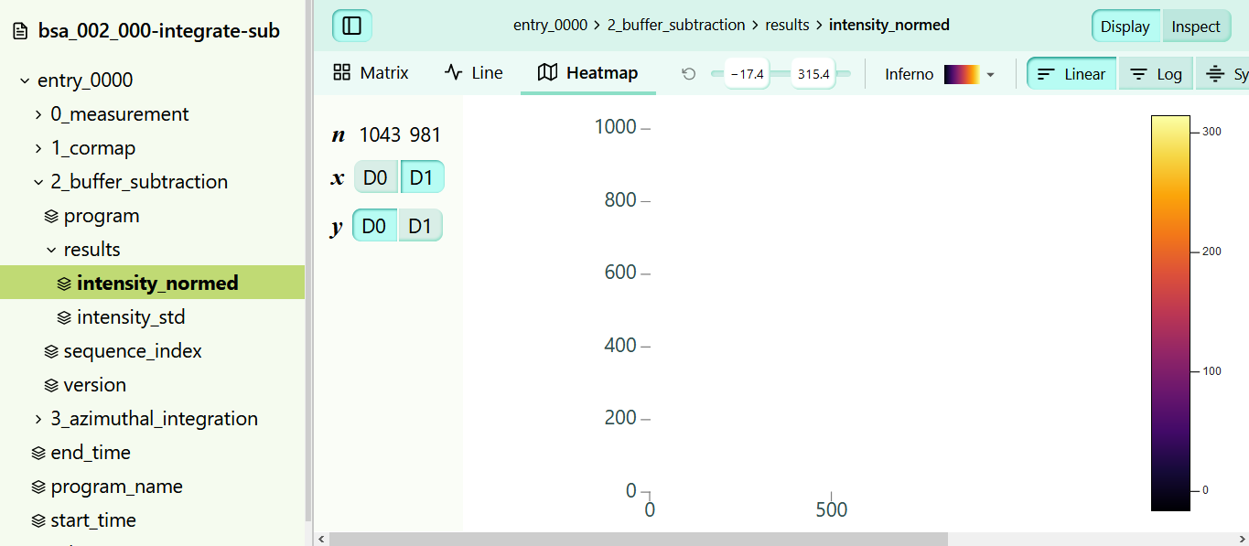
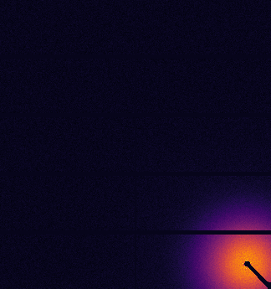
H5web – a web hdf5 viewer
Features: performance (using webGL), integrated into Jupyter lab, re-usable components
This project has received funding from the European Union’s Horizon 2020 research and innovation programme under grant agreement No. 823852
See Demo @ https://h5web.panosc.eu/

Slide 45
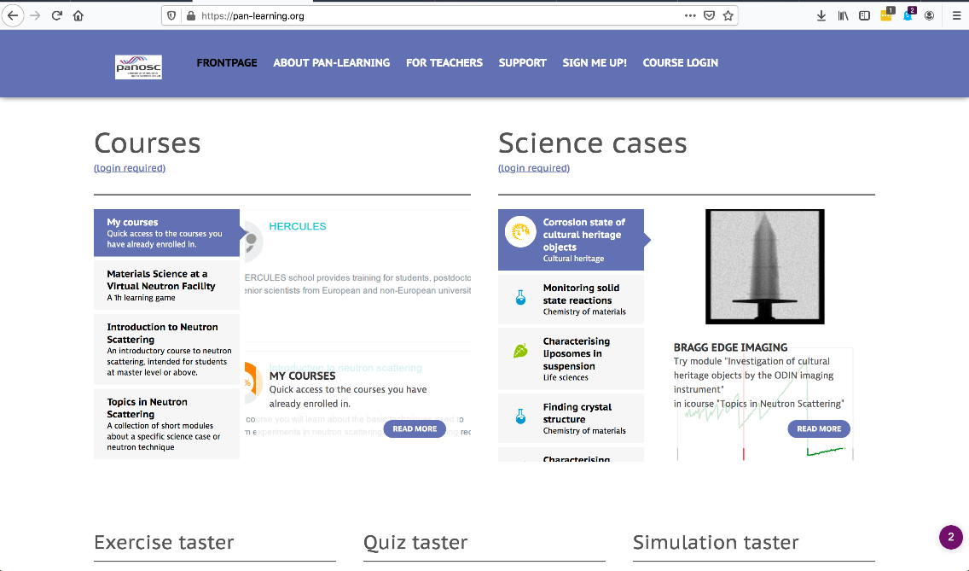


Staff and User Training
Provide training in data curation for staff & users
Use PaNOSC analysis and simulation services for training purposes in e-learning platform
E.g. for highlighting specificities & commonalities for P&N sources
Support for Jupyter Notebooks
pan-learning.org adapted from e-neutrons.org
Already contains plenty of training material for neutron scattering
This project has received funding from the European Union’s Horizon 2020 research and innovation programme under grant agreement No. 823852
credits – Thomas Rod
Notes:
Pan-learning.org is e-neutrons.org migrated to ESS with the purpose of sustaining it (facility hosted) and expanding it to also cover photon scattering.

Slide 46

PaN Commons
Vision – create a common space for Photon and Neutron facilities where petabytes of PaN data, analysis software, notebooks, analysis software, workflows, and training material can be Found, Accessed (downloaded and/or executed), Re-Used + Improved i.e. FAIR
Remote access – the PaN commons will be accessible remotely while being executed locally (close to the data) or via the EOSC
Remote users – the PaN commons is enabling remote users and experiments (urgently required in the post-COVID-19 phase)
This project has received funding from the European Union’s Horizon 2020 research and innovation programme under grant agreement No. 823852

Slide 47
Conclusion
Priority –PaNOSC priority has increased significantly due to increased need for remote access (post-COVID-19). COVID-19 demonstrated the need for PaNOSC and that we (PaNOSC + EOSC) still have work to do
EOSC – interacting with the EOSC remains a challenge but we hope that in 2021 with the legal entity being created the EOSC will stabilise and be easier to interact
Collaboration – with ExPaNDS is essential and is working well; collaboration with INFRAEOSC-04 clusters is increasing; with Users during remaining 30 months of project is key to the success of the project
Users – PaNOSC is focusing on real use cases for the remainder of the project; PLEASE let us know about your Use Cases !
This project has received funding from the European Union’s Horizon 2020 research and innovation programme under grant agreement No. 823852

Slide 48
Thank you to all PaNOSC project members for their contributions to the project and sharing a common vision!
andy.gotz@esrf.fr

Slide 49
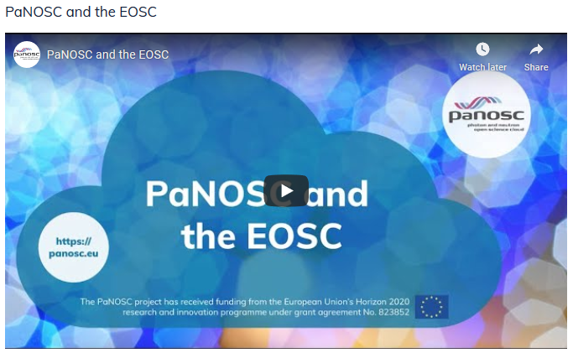
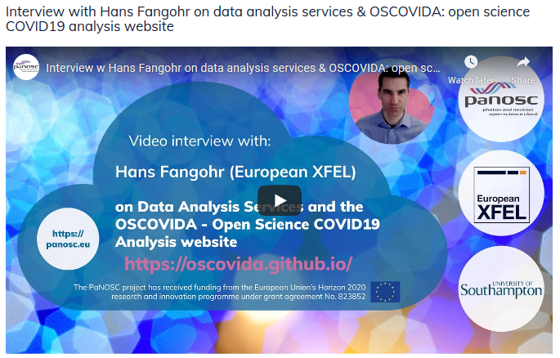
Watch these videos: https://www.panosc.eu/video/

Slide 50
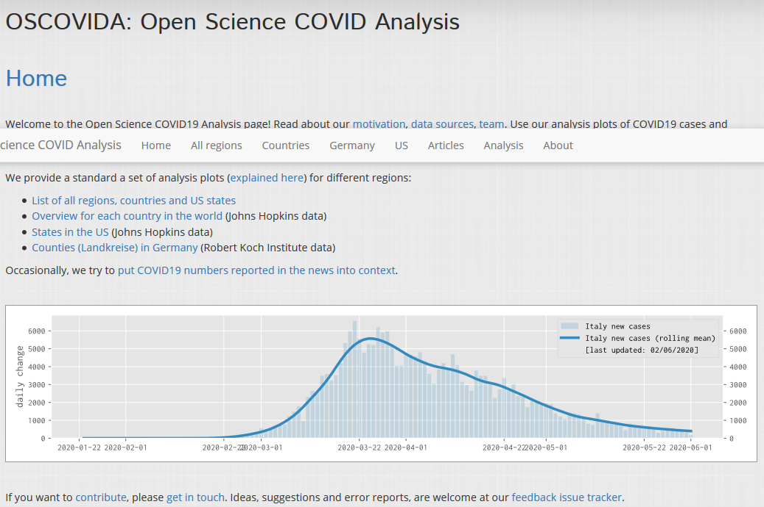
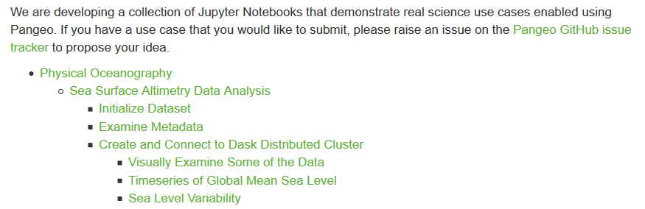
Common space to share open science workflows
e.g. EuXFEL OSCOVIDA example of citizen science Jupyter notebooks
Future → provide a catalogue of notebooks and workflows for analyzing data from different experimental techniques e.g. like the PANGEO project does (https://pangeo.io/use_cases/index.html)
https://oscovida.github.io/
This project has received funding from the European Union’s Horizon 2020 research and innovation programme under grant agreement No. 823852

